Slide 1


Mini Project (CSE7102)
REVIEW-1
29-08-2026
Presidency
School of Computer Science and Engineering

Slide 2
Emergency Shelter Allocation Platform
CSS7102- Mini Project Review-1
Project ID:
Panel No:
Group members details:
Under the Supervision of,
Mr. Irfan Rajab Bhat
Associate Professor
School of Computer Science and Engineering
Presidency University
Sl.No | Student Name | Roll Number
1 | Sharan Poojari (Team Leader) | 20231ISE0089
2 | Suhas S Kattimani | 20231ISE0090
3 | Harshil Gurjar | 20231ISE0056
Name of the Program(s): Emergency Shelter Allocation Platform
Name of the HoD (Team Leader’s): Dr. Gopal K Shyam
Name of the Program Project Coordinator (Team Leader’s):
Name of the School Project Coordinators: Mr. Muthuraju V

Slide 3
INDEX
Problem Statement
Git Hub Link
Introduction
Literature Review
Architecture Diagram
Analysis of Problem Statement/Output Expected
Timeline of the Project(Gantt Chart)
References

Slide 4
Problem Statement Number:
Category (Hardware / Software / Both) : Software
Problem Description: Displaced populations during floods, cyclones and earthquakes must be matched to safe, capacity-limited shelters quickly and fairly. Manual allocation is slow, error-prone and does not scale across districts or hazard types. This project builds a pluggable pipeline that discovers hazard-safe shelters from open map data, estimates their capacity, and computes an optimal, capacity-constrained, vulnerability-aware allocation of displaced groups to shelters, validated on a real Assam flood scenario.
Difficulty Level: High

Slide 5
Github Link
The Github link provided should have public access permission.
Github Link: https://github.com/HarshilxAI/Emergency-Shelter-Allocation-Platform

Slide 6
Introduction
About the project: The Emergency Shelter Allocation Platform is a disaster-response decision-support system that identifies suitable emergency shelters and optimally allocates displaced populations to them during floods, cyclones and earthquakes. It is architected as a pluggable eight-stage pipeline (event setup, shelter discovery, suitability scoring, capacity estimation, population input, distance calculation, optimization and persistence, visualization and dashboard) so that the same engineering works for any Indian state and any hazard type, with only the data sources and suitability rules changing. Assam flood response is used as the fully validated pilot implementation, backtested against a real historical flood event. The platform is built entirely on free, open-source geospatial tools (OpenStreetMap, OpenRouteService, PuLP, Streamlit) so it can be adopted by resource-limited state disaster authorities without licensing cost.

Slide 7
Literature Review
10 IEEE Xplore papers were reviewed, spanning shelter-allocation optimisation, GIS-based flood/hazard analysis and open-source disaster mapping:
Paper Title | Source | IEEE Xplore Link
Optimization of Emergency Logistics Scheduling in Complex Disaster Relief Situations | IEEE, 2024 | ieeexplore.ieee.org/document/10703875
An Optimized Resource Allocation Approach in Limited Emergency Situations using NSGA-II | IEEE, 2024 | ieeexplore.ieee.org/document/10429276
Urban Emergency Shelter Site Selection | IEEE Conf. | ieeexplore.ieee.org/document/8256375
Designing an Optimization Model for Dynamic Facility-Location Problem at Post-Disaster Area Considering Uncertainty | IEEE, 2022 | ieeexplore.ieee.org/document/10031495
Disaster Management System Based on GIS Web Services | IEEE Conf. | ieeexplore.ieee.org/document/5712855
OpenStreetMap for the Disaster Management in Bangladesh | IEEE Conf. | ieeexplore.ieee.org/document/6079240
Open Source Web-Based GIS and Database Tools for Emergency Response | IEEE Conf. | ieeexplore.ieee.org/document/4636686
WebGIS-Based Flood Emergency Management Scenario | IEEE Conf. | ieeexplore.ieee.org/document/4782684
GIS Support for Flood Rescue | IEEE Conf. | ieeexplore.ieee.org/document/4423474
Risk Zoning of Flood Disaster Based on GIS: Xiangjiang River, Hunan Province, China | IEEE Conf. | ieeexplore.ieee.org/document/5964809

Slide 8
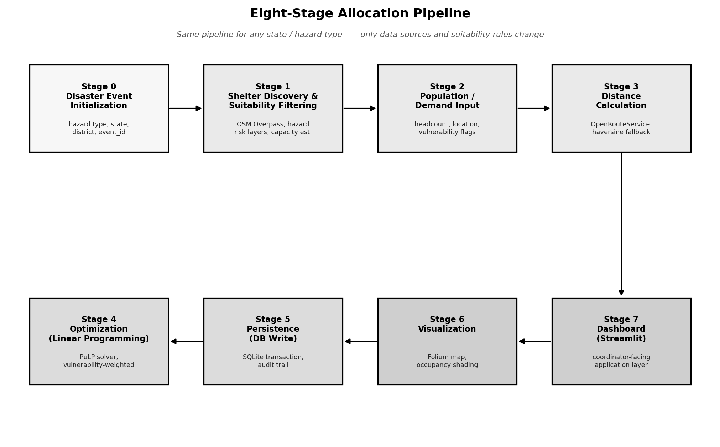
Architecture Diagram

Slide 9
Analysis of Problem Statement /Output Expected
Explain about the expected output from this project A working Streamlit dashboard where a coordinator selects/creates a disaster event and gets:
  Suitable shelters map — candidate buildings filtered and scored for the active hazard, with an estimated capacity for each.
  • Allocation results table — population group, assigned shelter, people housed, and distance travelled.
  • Live occupancy map — shelters shaded by occupancy, with lines joining each group to its assigned shelter.
  • Unmet-demand alert — any group that cannot be fully housed is reported explicitly as a waitlist, not silently overcrowded.
  • Backtest report — model allocation compared against the real historical Assam flood shelter response.
  •

Slide 10
Analysis of Problem Statement (contd...)
Software and Hardware Requirements: Python, Streamlit (dashboard), Folium/Leaflet (maps), OpenStreetMap + Overpass API (building/road data), Nominatim (geocoding), OpenRouteService (routing, OSRM fallback), PuLP (linear programming optimisation), SQLite (database), GeoPandas (geospatial processing), Bhuvan/IMD/CWC (India hazard data).
Hardware Requirements:
Standard development laptop/PC (8 GB RAM, quad-core CPU, internet access for API calls); no specialised or GPU hardware required. Optional: cloud VM for shared department deployment.

Slide 11
Analysis of Problem Statement (contd...)
User Workflow:
Create Disaster Event → Identify Shelters → Enter Population → Calculate Distances → Run Allocation → View Results
The coordinator's only manual actions are creating the event, entering/uploading population data, and clicking Run Allocation — every other step (shelter scoring, distance calculation, optimisation, persistence, visualization) is automatic.

Slide 12
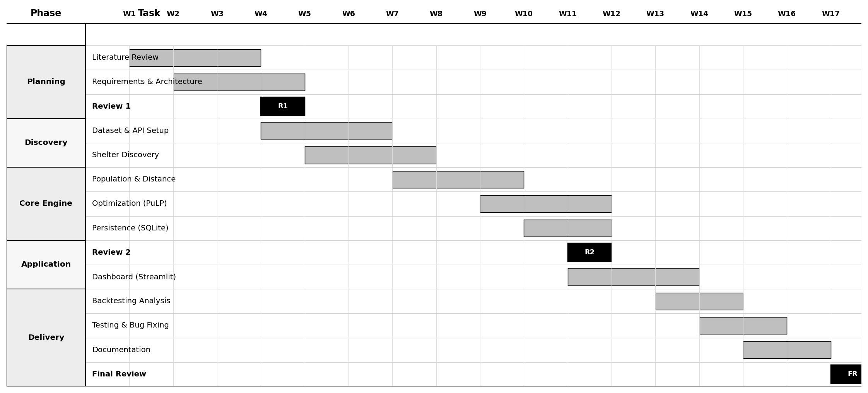
Timeline of the Project (Gantt Chart)

Slide 13
References (IEEE Paper format)
Add APA Citation for all references.
Use the below link for various APA styles :
https://www.indeed.com/career-advice/career-development/how-to-cite-a-research-paper
Author(s). Optimization of Emergency Logistics Scheduling in Complex Disaster Relief Situations. IEEE Xplore. https://ieeexplore.ieee.org/document/10703875
Author(s). An Optimized Resource Allocation Approach in Limited Emergency Situations using NSGA-II. IEEE Xplore. https://ieeexplore.ieee.org/document/10429276
Author(s). Urban Emergency Shelter Site Selection. IEEE Xplore. https://ieeexplore.ieee.org/document/8256375
Author(s). Designing an Optimization Model for Dynamic Facility-Location Problem at Post-Disaster Area Considering Uncertainty. IEEE Xplore. https://ieeexplore.ieee.org/document/10031495
Author(s). Disaster Management System Based on GIS Web Services. IEEE Xplore. https://ieeexplore.ieee.org/document/5712855
Author(s). OpenStreetMap for the Disaster Management in Bangladesh. IEEE Xplore. https://ieeexplore.ieee.org/document/6079240
Author(s). Open Source Web-Based GIS and Database Tools for Emergency Response. IEEE Xplore. https://ieeexplore.ieee.org/document/4636686
Author(s). WebGIS-Based Flood Emergency Management Scenario. IEEE Xplore. https://ieeexplore.ieee.org/document/4782684
Author(s). GIS Support for Flood Rescue. IEEE Xplore. https://ieeexplore.ieee.org/document/4423474
Author(s). Risk Zoning of Flood Disaster Based on GIS: Xiangjiang River, Hunan Province, China. IEEE Xplore. https://ieeexplore.ieee.org/document/5964809
Sphere Association (2018). The Sphere Handbook: Humanitarian Charter and Minimum Standards in Humanitarian Response.

Slide 14


